Slide 1
Secrets of the Motherboard
Graham Sutherland
Security Advisory EMEAR, Cisco Advanced Services
44CON 2017

Slide 2
Hello.
Twitter: @gsuberland
StackExchange: Polynomial
Email: gsutherl@cisco.com

Slide 3
Where it all began
Tweets by @whitequark used with permission.

Slide 4
Scope of this talk
Identifying security issues with modern computer hardware (treat it just like IoT devices!)
Attempts at restoring privacy, ownership, and security
Architectural failings in hardware design
Code and data persistence
Secure hardware re-use
Amusing findings along the way
Why this talk?
Many talks focus on single issue(s)
Nobody (afaik) has done a wide-coverage "state of play" talk

Slide 5
Acknowledging previous work
American Megatrends / Lenovo SMM vulnerability (Sogeti ESEC)
CVE-2017-5689 in AMT (Maksim Malyutin, Embedi)
Intel ME Secrets (Igor Skochinsky, RECON 2014)
me_cleaner (Nicola Corna, many others)
Chris Tarnovsky’s work on TPMs (particularly DEFCON 20 talk)
[1] http://esec-lab.sogeti.com/posts/2016/05/30/smm-unchecked-pointer-vulnerability.html
[2] https://www.embedi.com/news/mythbusters-cve-2017-5689
[3] https://recon.cx/2014/slides/Recon%202014%20Skochinsky.pdf
[4] https://github.com/corna/me_cleaner
[5] https://www.youtube.com/watch?v=Bp26rPw90Dc

Slide 6
Read your chipset datasheet
Chipset is a consumer colloquialism for what Intel calls the Platform Controller Hub (PCH)
Yes, you can just download the datasheet.
Free!
No account needed!
Contains all the useful things:
Pinout, signal names, voltage levels
Feature descriptions, configuration registers
Architectural diagrams, implementation notes

Slide 7
This sounds crazy!
It’s actually not that hard.
Little domain-specific knowledge required.
Ask people for help when you’re confused.
Twitter
IRC (Freenode #libreboot & #coreboot were a great help)

Slide 8
Section 1: Messing with IME

Slide 9
Rationale
Always running.
Has memory access.
Direct NIC access.
Closed platform.
No way to assess security.

Slide 10
IME Debug Mode
Flash Descriptor Override Pin-Strap Status (FDOPSS)
“Read Only: This bit indicates the condition of the FDOPSS / Intel ME Debug Mode Pin-Strap.”
“The […] ME Debug Mode strap is set using external pull-up on HDA_SDO”
Intel 7-Series (Z79/C600) Platform Controller Hub (PCH) Datasheet
Page 755, Section 22.1.2 “HSFS – Hardware Sequencing Flash Status Register”
Notes:
Chipset datasheet: https://www.intel.com/content/dam/www/public/us/en/documents/datasheets/7-series-chipset-pch-datasheet.pdf

Slide 11
IME Debug Mode
Intel 7-Series (Z79/C600) Platform Controller Hub (PCH) Datasheet
Page 78, Table 2-26 “Functional Strap Definitions”
Notes:
Chipset datasheet: https://www.intel.com/content/dam/www/public/us/en/documents/datasheets/7-series-chipset-pch-datasheet.pdf

Slide 12
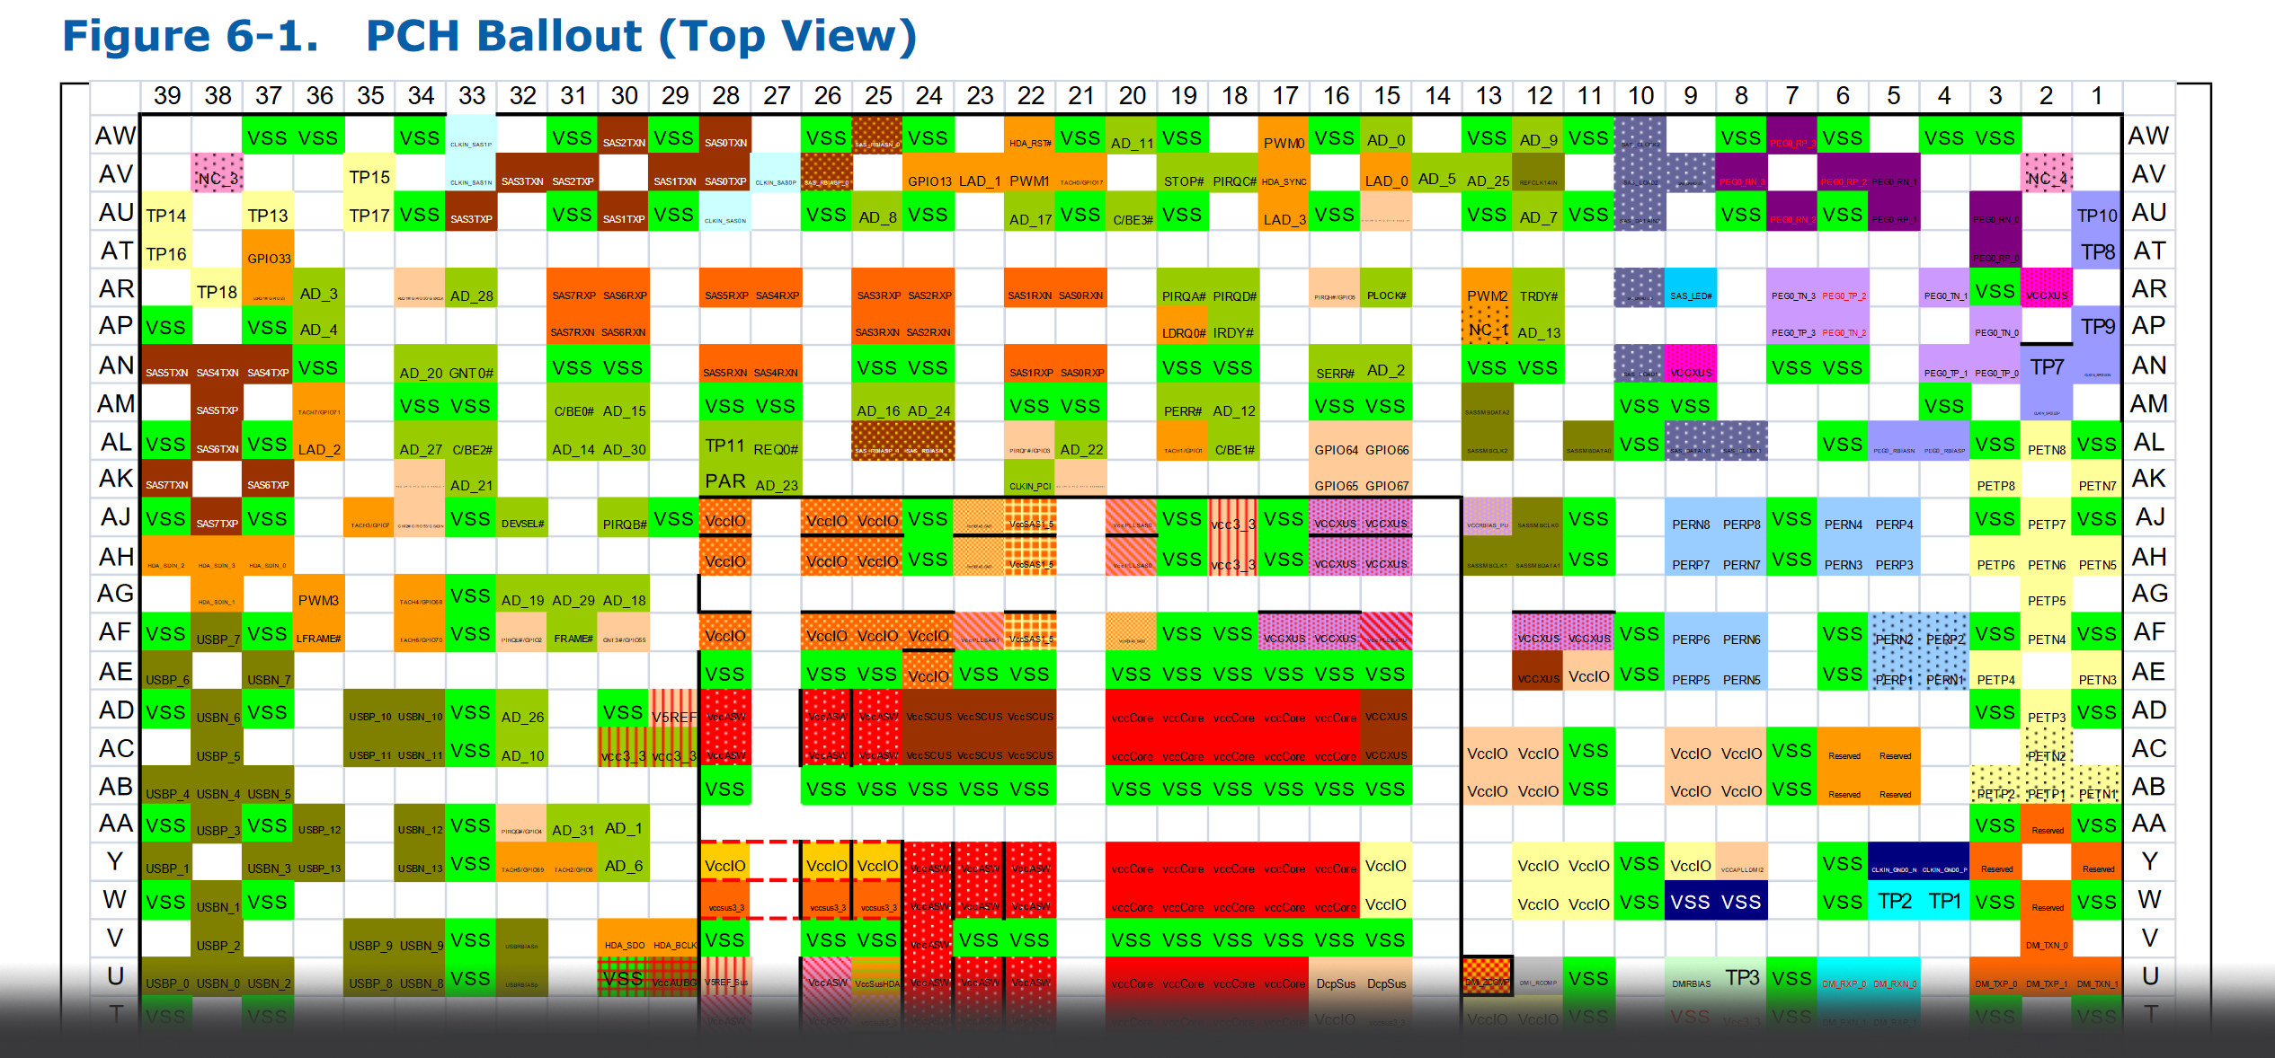
IME Debug Mode
Intel 7-Series (Z79/C600) Platform Controller Hub (PCH) Datasheet
Page 78, Table 2-26 “Functional Strap Definitions”
Notes:
Chipset datasheet: https://www.intel.com/content/dam/www/public/us/en/documents/datasheets/7-series-chipset-pch-datasheet.pdf

Slide 13
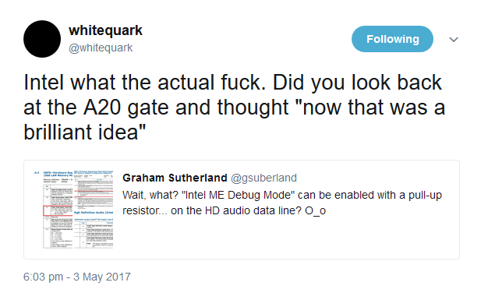
Posted findings
***
Tweets by @whitequark used with permission.

Slide 14
What do we know?
HDA_SDO is the HD Audio Serial Data Out line.
This is a physical wire from the PCH to the HDA codec IC.
Unfortunately the PCH is a BGA part and it’s not an edge pin ☹
Pulling HDA_SDO low at boot puts IME into debug mode.
IME debug mode unlocks some registers.
Intel says it “must not be asserted”.
Notes:
Chipset datasheet: https://www.intel.com/content/dam/www/public/us/en/documents/datasheets/c600-series-chipset-datasheet.pdf page 78

Slide 15
What don't we know?
Aside from config registers, what does ME debug actually do?
Where can we access HDA_SDO?
What happens if we mess with those registers?

Slide 16
Someone else to the rescue
Always look for prior research!
HDA_SDO strap already explored by libreboot/coreboot and me_cleaner folks
Stops IME from executing ☺
Breaks integrated GbE NIC ☹
Sets 30 minute shutdown timer ☹
Intel ME sectors are signed ☹

Slide 17
Neutralising IME – option 1
Find HDA_SDO on board (HDA codec IC easiest)
Pull HDA_SDO to GND to assert ME Debug strap
Boot the system
Dump ME firmware flash from mapped memory
Neutralise with me_cleaner
Write neutralised image back to ME flash
Reboot

Slide 18
Neutralising IME – option 2
Find ME flash device on board (8-pin SPI flash)
Desolder it or use IC clip
Use flashrom to dump the ME firmware flash
Neutralise with me_cleaner
Write neutralised image back to ME flash
Reboot
[1] https://hardenedlinux.github.io/firmware/2016/11/17/neutralize_ME_firmware_on_sandybridge_and_ivybridge.html

Slide 19
me_cleaner approach
ME firmware is split into partitions
Partitions are signed (signature in partition header)
Image starts with Firmware Partition Table (FPT)
FPT itself is not signed!
Can just remove partitions (and headers containing signature) and this does not trigger the shutdown timer.
Only partition that cannot be removed is factory partition (FTPR)

Slide 20
Problem
These modifications require you to touch hardware, and that sucks.

Slide 21
Problem
No motherboard designer would expose IME straps in a way that we might abuse…

Slide 22
Or would they? (Dell)
keyboard controller
Notes:
Board schematics found online on laptop repair forums.

Slide 23
Or would they? (Toshiba)
keyboard controller
Notes:
Board schematics found online on laptop repair forums.

Slide 24
Or would they? (Acer)
keyboard controller
Notes:
Board schematics found online on laptop repair forums.

Slide 25
Or would they?
Notes:
Board info found online on laptop repair forums.

Slide 26
Broken by specification
“Let’s expose HDA_SDO externally!”
Intel HD Audio specification
6.12 - Hot Attach Mechanisms
“An important feature for High Definition Audio is supporting hot attach. A typical example is connecting the Codec on the docking station.”

Slide 27
Docking
Idea: assert ME Debug strap via docking connector on a laptop. No disassembly!
Reality: docking connectors are proprietary, change between laptop models, and aren’t documented.
Looked pretty hard, didn’t find anyone using hot attach on a docking connector ☹

Slide 28
Future work
Identify and document convenient locations to interfere with IME (HDA_SDO pins, ME firmware flash IC) on various platforms.
Find a way to restore GbE NIC without ME access.

Slide 29
Except…
Someone found a better way!

Slide 30
HAP
High Availability Platform
Hidden flag to disable ME
Discovered by Mark Ermolov, Maxim Goryachy http://blog.ptsecurity.com/2017/08/disabling-intel-me.html
Released into me_cleaner in August 2017.
Still breaks GbE NIC in many cases though.

Slide 31
Section 2: Architectural security issues

Slide 32
Architectural security concerns
“Privileged” buses with non-privileged devices on them.
Security-critical devices (keyboard, TPM, NIC) sharing a bus with other devices.

Slide 33
How do we find these?
Look at all the motherboards!
… expensive?
Leaked docs & right to repair ftw :D

Slide 34
Why does my RAM have access to the NIC?
DIMM socket
LAN controller
Notes:
Board schematic found on a laptop repair forum.

Slide 35
Why does my RAM have access to the WiFi?
DIMM socket
WiFi SoC
Notes:
Board schematic found on a laptop repair forum.

Slide 36
New proposed concept
Internet of DIMMs

Slide 37
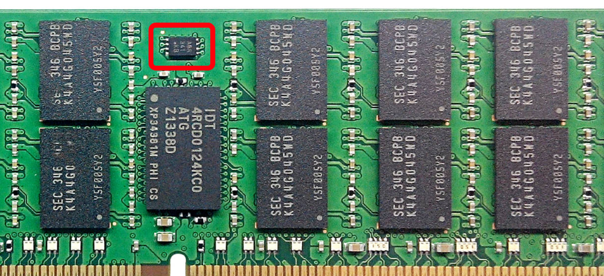
Serial Presence Detect (SPD)
IC on DIMM used to store RAM config data
Talks via SMBus to PCH
Should be an SMBus slave device
SMBus is multimaster by design
What’s stopping it? (nothing)

Slide 38
SPD
SPD IC == EEPROM
Common: ST M34xx, Microchip 34AAxx, Micron TN-04-42
Fairly ubiquitous pinout (3x address select, Vss, SDA, SCL, write control, VCC)
Coincidence: ATTiny85 has compatible pinout

Slide 39
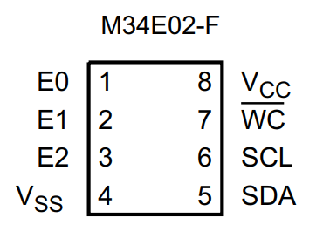
MCU as an SPD

Slide 40
Approach
Replace SPD EEPROM with ATTiny85.
Use ATTiny85’s internal EEPROM for SPD data.
Interrupt-driven SMBus listener on PB0/PB1.
Evil mode: become SMBus master and send network packets via the IME.

Slide 41
Status
Fake SPD working (contains normal SPD data)
SMBus Master code not complete (yet!)
Plan: magic value to SPD, sends packets
Worked out some of the NIC commands
Ongoing development, no demo yet ☹

Slide 42
Section 3: Persistence

Slide 43
Persisting outside HDD
UEFI/BIOS
IME firmware?
SMM?
Peripherals
RAM
Other motherboard ICs

Slide 44
UEFI/BIOS
User-flashable
Updates are usually signed ☹
Data persistence possibly via empty config sections
Code persistence unlikely with SecureBoot
Likely requires targeted attack

Slide 45
IME firmware
Physical access required to flash
Some regions OS-accessible (Intel Flash Descriptor)
Huffman coded but RE’ed (thanks to nico_h for this info!)
Potentially useful

Slide 46
SMM
Not easily writable, as far as I know
Very hard to read even from ring0 (SMRAM)
People have done lots of research here, very new results suggest there may be ways to dump/write SMRAM

Slide 47
Peripherals
Peripheral devices (GPU, NIC, SSD) with firmware
User-upgradeable from software
Variable checking of signatures
Potentially useful for storing secrets

Slide 48
RAM
No, not the volatile bit.
SPD flash is read/write from kernel space
Known to be an exfiltration vector
Slack space & unused fields useful for secret storage
XSS via SPD flash (lol)

Slide 49
Other motherboard ICs
PCH has volatile scratch registers
RAID controller firmware
Non-volatile flash space in sensors
Hard disk environmental logging

Slide 50
Section 4: Secure Re-use

Slide 51
Serious concerns
Modified firmware
Exploitation of firmware via modified data
Exfiltration / other contamination

Slide 52
Secure re-use approach
Work with motherboard and peripheral vendors to identify devices with non-volatile storage
Dump the contents of these devices
Boot and use the system
Reflash the contents of the devices, verify writes and check stability
Store as known-good state
Restore before hardware crosses customer boundaries

Slide 53
Challenges
Vendors may be unhelpful (e.g. HDD manufacturers get very cagey about you messing with the telemetry flash!)
Known-good state must be validated before customer use in the first place; this cannot be retroactive.
Laborious task. Requires staged reflashing and verification of writes + post-boot stability.
Potential failure state is permabricked hardware.
Loss or compromise of known-good states is catastrophic.

Slide 54
Solutions
Good vendor relationships.
Early identification of risk. Invest early, plan appropriately.
Automation where possible. Hardware interface jigs help reduce manual effort.
Clear procedure and multiple validation and verification checks help eliminate potential bricking of hardware.
Secure & redundant storage of the states.

Slide 55
Conclusions

Slide 56
Conclusions
You should look at your hardware datasheets!
Board designs are very complex, so the potential for the designer to make mistakes is high.
Supply chain attacks don’t necessarily need to target security-critical devices.
Secure re-use of hardware is difficult.

Slide 57
Special thanks
@whitequark
Tim Brown (@timb_machine)
Anonymous hardware security guy
nico_h and jn__ on #coreboot
Lots of people from #libreboot

Slide 58
The end. Questions?

